Slide 1
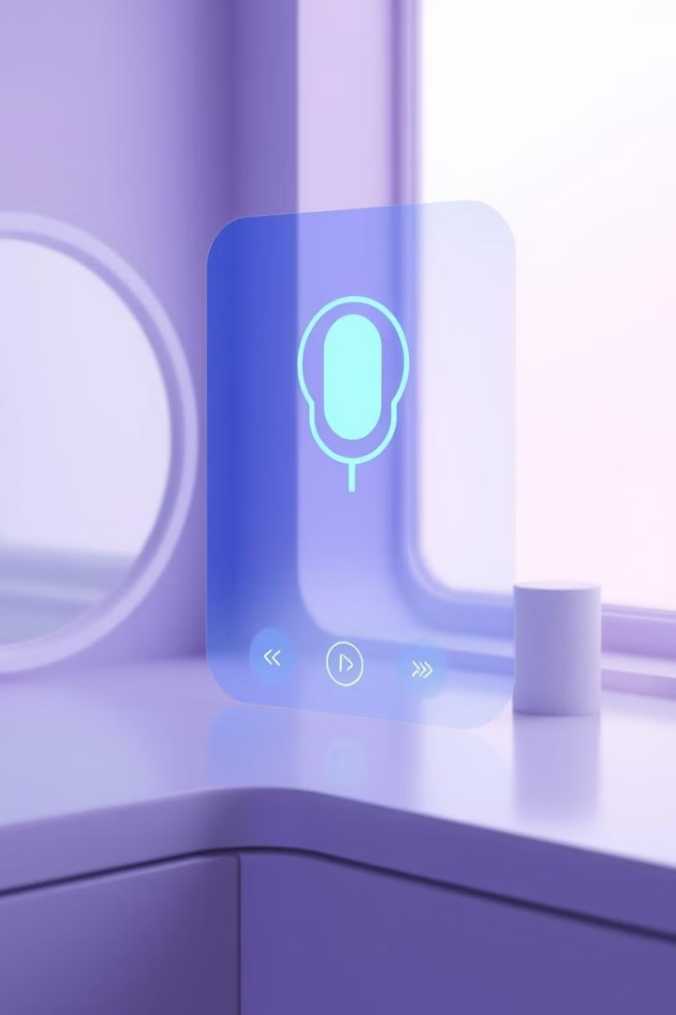

Introducing Zax: Your AI-Powered Voice Assistant
Welcome to the future of voice interaction! Today, we're introducing Zax, your personal AI-powered voice assistant.

Slide 2
Revolutionizing the Way You Interact with Technology
Effortless Control
Personalized Experience
Enhanced Accessibility
Zax makes it easy to manage your devices using only your voice. Simply speak your commands and watch as your devices respond instantly.
Zax learns your preferences and habits, tailoring its responses and suggestions to your individual needs.
Zax is designed for everyone. It provides intuitive voice controls for individuals with disabilities, making technology more accessible.

Slide 3
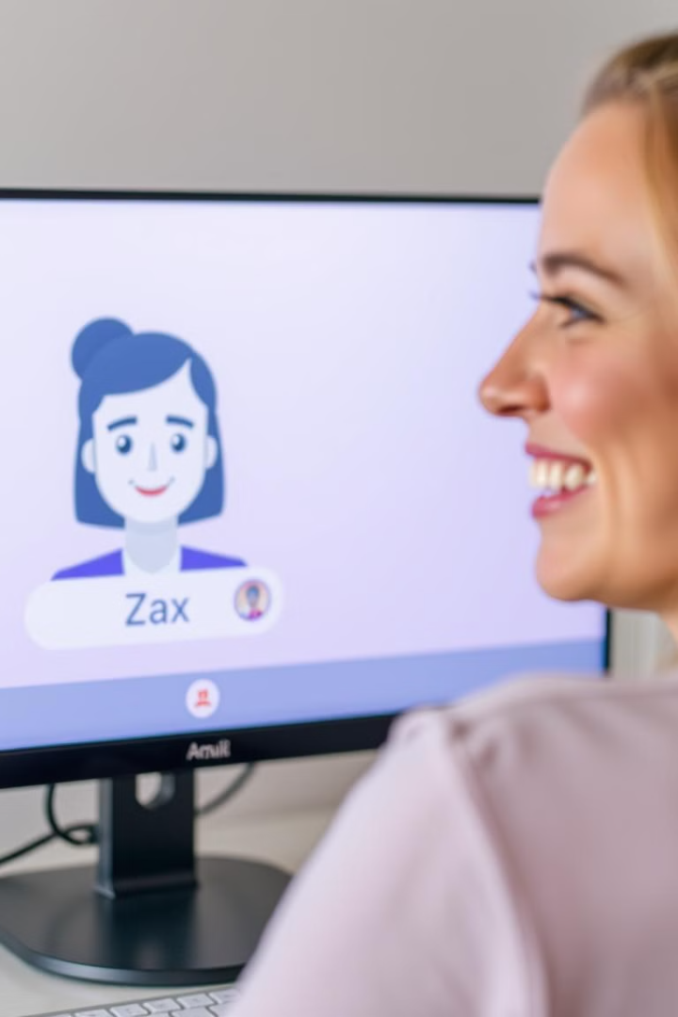
Key Features of Zax: Seamless Voice Control
1
Voice Recognition
2
Natural Language Processing
Zax accurately recognizes your voice and responds to your commands with high precision, even in noisy environments.
Zax can understand complex language and respond with helpful and accurate information.
3
Multi-Device Compatibility
Zax seamlessly integrates with a wide range of devices, including smartphones, smart speakers, and smart home appliances.

Slide 4
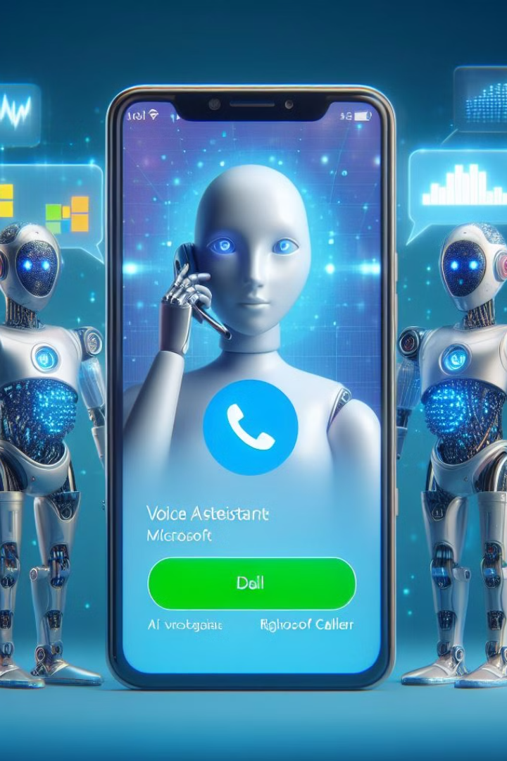
Zax's Natural Language Understanding Capabilities
Contextual Awareness
Learning and Adaptation
Zax remembers previous interactions and uses that information to provide more relevant and personalized responses.
Zax constantly learns and adapts to your preferences and voice patterns, becoming even more accurate and helpful over time.
Multilingual Support
Zax supports multiple languages, making it accessible to a global audience.

Slide 5




Personalized User Experience with Zax
User Profiles
Zax allows you to create multiple profiles for different users in your household, ensuring a personalized experience for each individual.
Personalized Reminders
Zax can remind you of important appointments, deadlines, and tasks, helping you stay organized and on top of your schedule.
Custom Music Playlists
Zax uses your music preferences to create personalized playlists for your listening enjoyment.

Slide 6

Zax's Integration with Smart Home Devices
Smart Lighting
Security and Surveillance
Control your home's lighting with voice commands, creating the perfect ambiance for any occasion.
Monitor your home with integrated security cameras and door locks, all controlled through Zax.
1
2
3
Temperature Control
Adjust the temperature of your home with ease, ensuring comfort and energy efficiency.

Slide 7
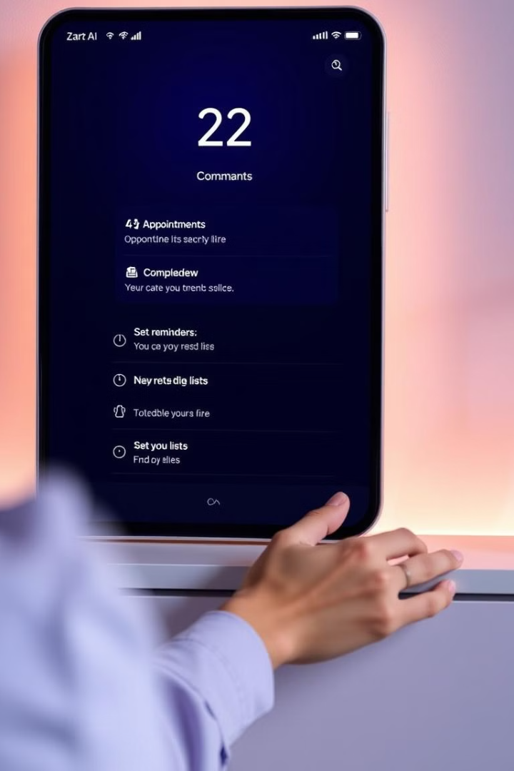



Enhancing Productivity and Efficiency with Zax
Scheduling and Reminders
Zax helps you stay on top of your busy schedule by managing appointments, meetings, and deadlines.
Task Management
Create to-do lists, set priorities, and manage tasks efficiently with Zax's voice commands.
Information Retrieval
Zax provides quick access to information, such as weather updates, news headlines, and directions.

Slide 8





The Future of Intelligent Voice Assistants: Zax's Roadmap
1
Enhanced Voice Recognition
2
Advanced AI Capabilities
3
Integration with Smart Home Ecosystems
4
Expanded Device Compatibility
5
Personalized AI Assistant

Slide 9
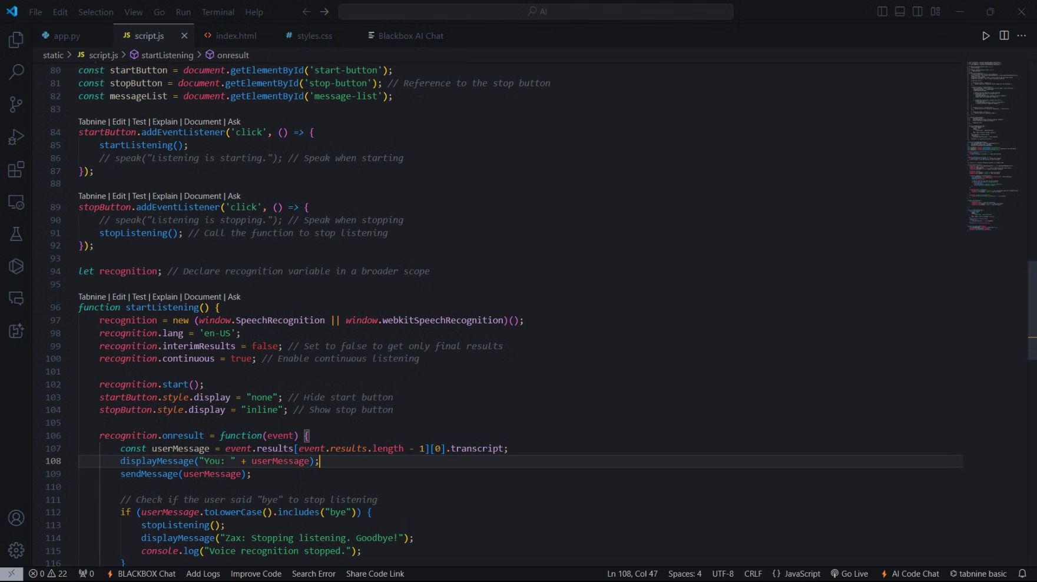
server end

Slide 10
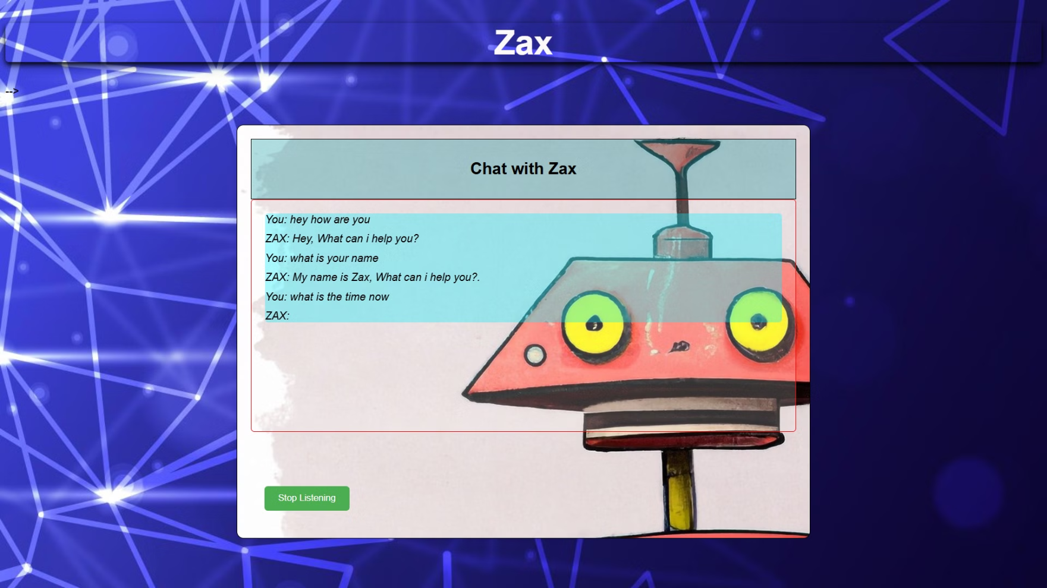
how it"s look like (ZAX voice assistant ai)

Slide 11



Slide 12
Submitted To:- Submitted By:-
Assitant HOD. Dr. Jitendra Singh Kushwah
Ratnesh vansh saxsena(0905it211098)
{Department of IT} Saurav kumar(0905it211109)
(ITM GWALIOR) Sanskriti samadhiya(0905it211106)
Shivani verma(0905it211115)
Shubhi gupta(0905it211119)

